Slide 1

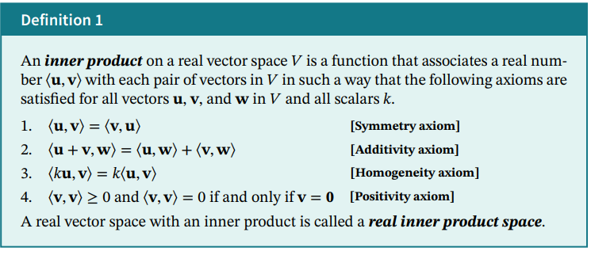

Slide 2


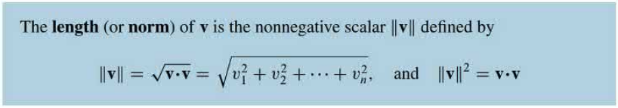

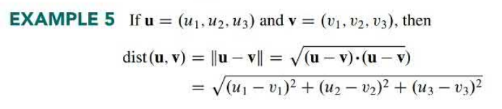

Euclidean inner product (or the standard inner product) on $R^{n}:$
Distance between two vectors is denoted by d(u, v) and is defined by

Slide 3
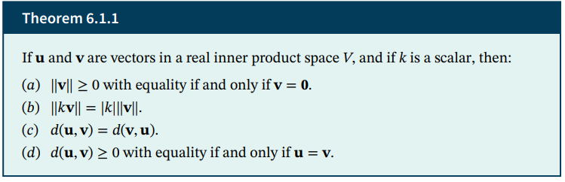


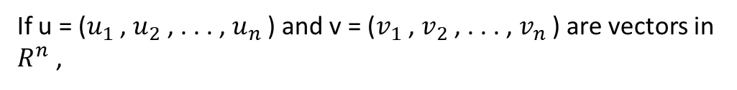
Weighted Euclidean inner product:
Let $w_{1}$ , $w_{2}$, . . . , $w_{n}$ are positive real numbers .
If u = ($u_{1}$ , $u_{2}$ , . . . , $u_{n}$ ) and v = ($v_{1}$ , $v_{2}$ , . . . , $v_{n}$ ) are vectors in $R^{n}$ ,
called weighted Euclidean Inner product with weights $w_{1}$ , $w_{2}$, . . . , $w_{n}$.

Slide 4
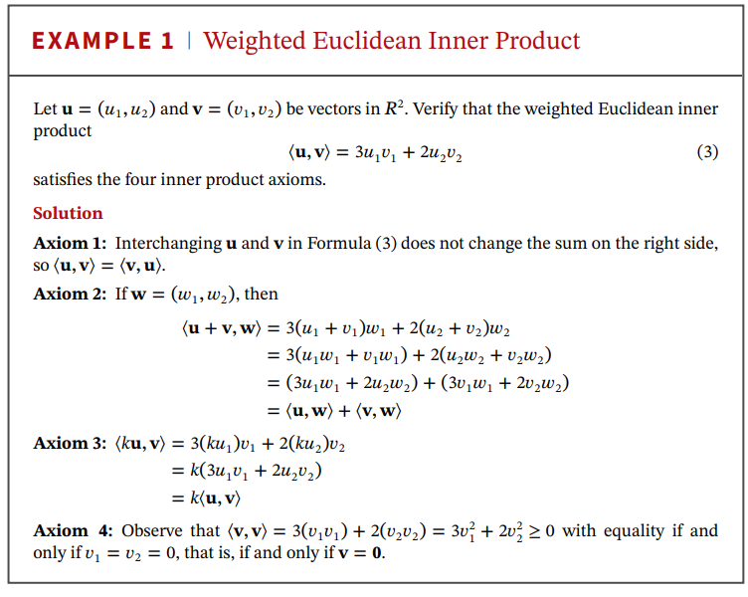

Slide 5

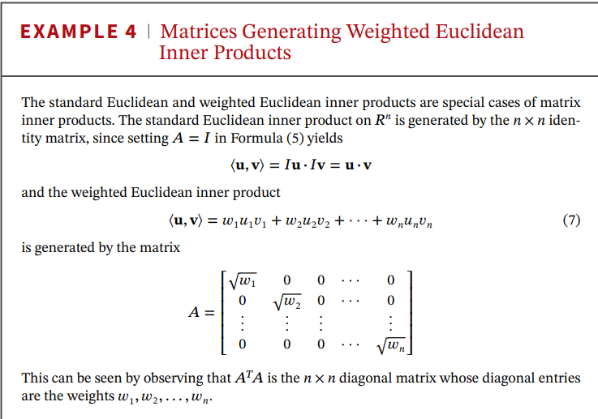



Let u and v be vectors in $R^{n}$ that are expressed in column form, and let 𝐴 be an n × n matrix.
=${(Av)}^{T}Au=v^{T}A^{T}Au$
It is called the inner product on $R^{n}$ generated by 𝑨.
For Euclidean inner product (or the standard inner product) on $R^{n}:$

Slide 6
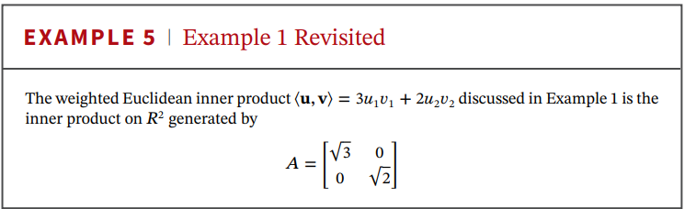

Slide 7




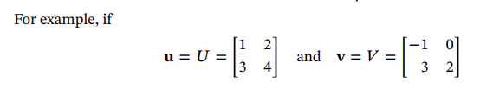


⟨U, V⟩ : multiply corresponding entries and add
⟨U, V⟩ =

Slide 8
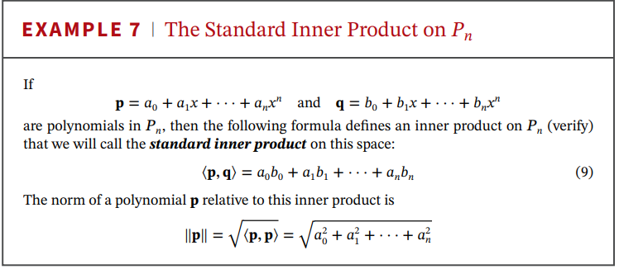

Slide 9
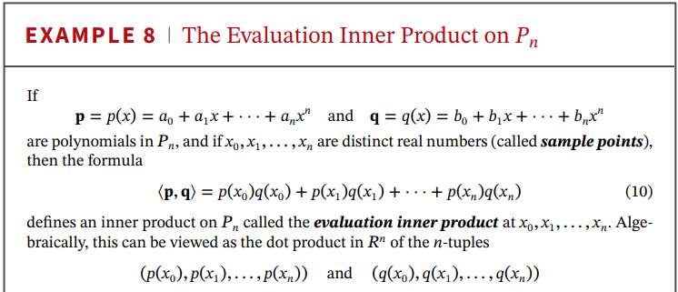


Slide 10
